Slide 1

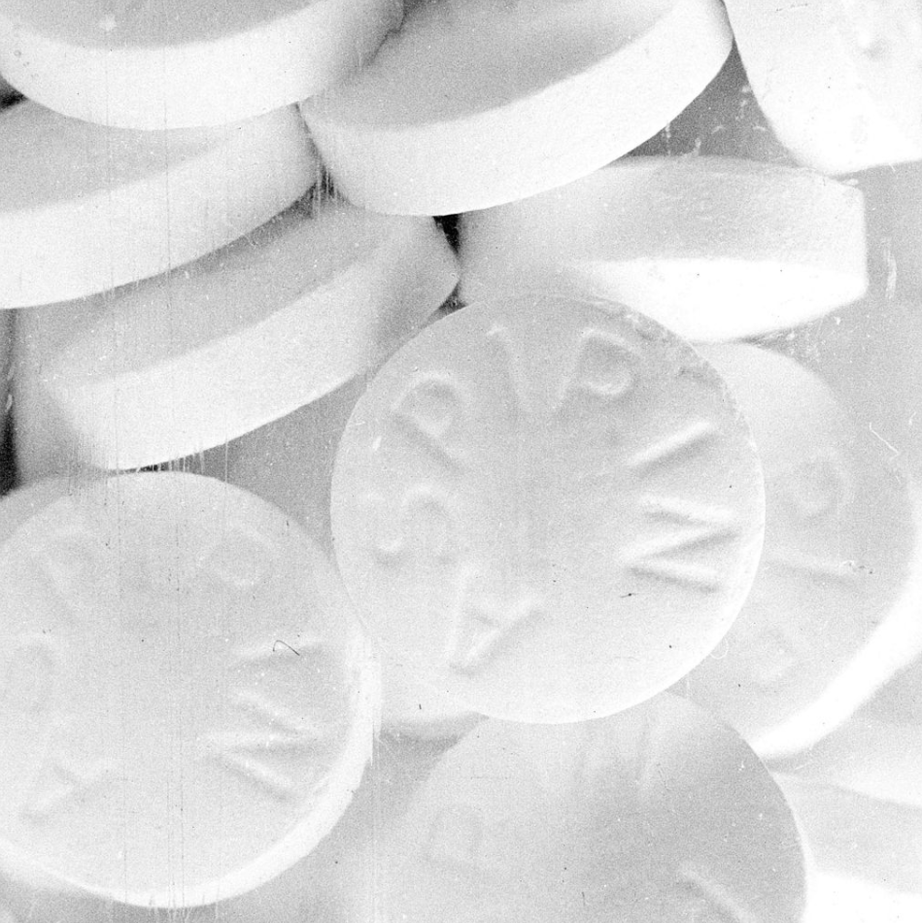
Drug-Drug interaction discovery (DDI)
Guy Shtar
DMBI 2018 @ BGU

Slide 2
Motivation
Estimates of the numbers of patients injured due to drug interactions ranging from 3 to 5% of all in-hospital medication errors
Clinical trials for new drugs doesn't address the issue of DDI directly
Drug-drug interactions are preventable

Slide 3
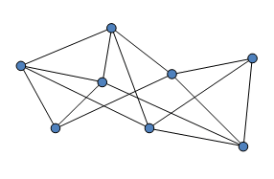
Problem formulation
Given an undirected graph G = (V, E)
Nodes represent drugs
Edges represent interactions
Predict unknown interactions
Drug names are not given
additional data is not allowed
d1
?
d2

Slide 4
Evaluation
You are given an older version of the drug database
The database we use is being updated periodically
Your submission will be evaluated on a newer version of the database
Evaluation metric:
Area under ROC curve. AUC.

Slide 5
Data structure
Edge1 | Edge2
0 | 1
1 | 2
0 | 2
2 | 4
6 | 7
Input: CSV file
2 columns, representing an edge. Each column is a node
No edges from node to itself
Output: CSV file
3 columns, representing an edge and it’s prediction.
Predictions for interactions which exists in older version will be ignored
Missing predictions will be filled with 0’s.
Input CSV structure example
Edge1 | Edge2 | Prediction
0 | 4 | 0.1
1 | 3 | 0.8
6 | 5 | 0.9
7 | 4 | 0.01
3 | 7 | 0.001
Partial output CSV structure example

Slide 6
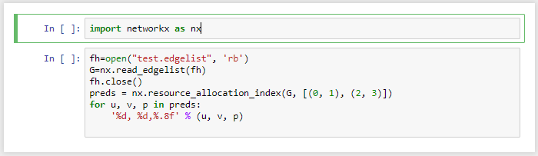
Short code example
Full example of simple solution will be given at main event
Including: reading csv, predicting using GraphX, writing output and evaluating

